Slide 1



Blusmart
Product Teardown
1. Sanchit Garg
2.Shivam Goyal
3.Tanu Agarwal

Slide 2
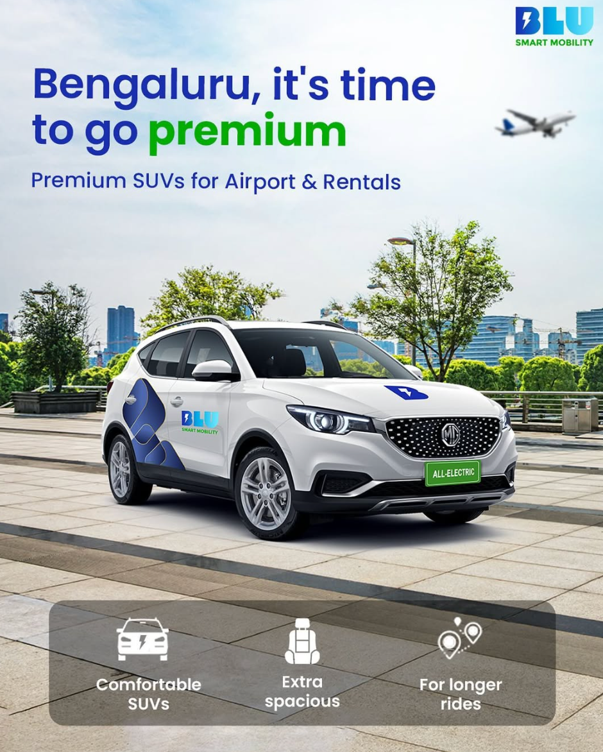

Brief Overviw
Introduction paragraph
BluSmart Mobility is an Indian ride-sharing company, headquartered in Gurugram, India.
Founded by Anmol Singh Jaggi, Punit Goyal, and Puneet Singh Jaggi in 2019.
Vehicles include the Mahindra e-Verito, Tata e-Tigor, Tata Xpres-T EV, Hyundai Kona Electric, and MG ZS Electric.

Slide 3
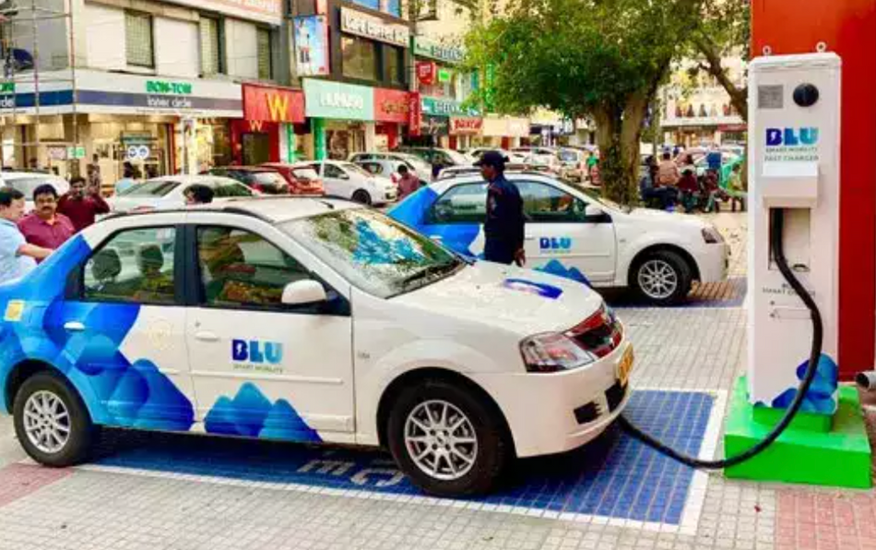
Business model
Operating in Bengaluru and Delhi
BluSmart's business model combines offering eco-friendly, app-based EV cab rides with a company-owned fleet for reliable and transparent services.
It also generates revenue by developing and managing EV charging infrastructure, supporting its fleet and the broader EV ecosystem.
COMPANY MILESTONES
BluSmart secured $24 million (INR 200 crore) in a Pre-Series B funding round to support its expansion
The company continues to focus on its mission to provide sustainable and reliable electric mobility solutions in India.
Blusmart was founded in Gurugram,India
Launched its operations in Mumbai
2019
2020
2021
2022
2023
2024
2025
Blusmart launched its operations in Gurugram,India and seed round
BluSmart raised $15 million in Series A funding.
BluSmart launched operations in Dubai, UAE

Slide 4



Differentiator
Their great vision
Fully electric cars contribute to reduced air pollution and carbon footprint.
No reliance on petrol or diesel, supporting cleaner energy use.
Allows users to schedule rides in advance for convenience.
Focus on clean, sanitized vehicles.
Professional and verified drivers to enhance passenger safety.
Promises no cancellations by drivers, ensuring reliability.
Aims to avoid the frustration often associated with last-minute ride cancellations.
Offers consistent pricing without fluctuation during peak hours or high-demand times.
Aligns with the goals of reducing urban pollution and promoting green mobility solutions.

Slide 5


Pain Points:-
Akash is concerned about environment and wants to use ride-hailing services that is better for planet.
Akash if often in a hurry and wants to find a cab that are reliable and efficient.
Goals:-
Akash values a ride-haling service that offers seamless music experience without any interruptions, making a convenience a top priority.
For him a smooth and enjoyable journey matters more than money or discounts.
Vignesh,30
90,000 Salary

Slide 6

Pain Points:-
Blu Smart's services might not be available in all the areas Rosy needs to travel, limiting her options for affordable rides.
Blu Smart may not consistently provide relevant coupons and discounts, which could hinder Rosy's ability to save money on her rides.
Goals:-
Rosy wants to find an affordable ride-hailing service.
She wants to have all the details of the driver on her phone to share them with her family for safety purposes.
Rosy,22
30,000 per month

Slide 7
Feature 1:
Weekly pass
By paying an upfront fee, customers can save money on rides within a specific time frame.
What is a Weekly Pass?
The Weekly Pass is a digital subscription service that allows customers to purchase a fixed number of rides for a set price within a week. This feature offers customers the flexibility and affordability of planning their rides over the course of the subscription period.
The pass eliminates the hassle of frequent payment calculations, offering unlimited rides for a week.
The weekly pass encourages frequent use of BluSmart services without additional charges, boosting customer satisfaction.
Target Audience for This Feature:
The weekly pass is tailored for diverse groups such as job holders, tourists, and those traveling for wedding shopping, ensuring a wide range of customer needs are met.
It’s a practical and economical option for regular commuters, ensuring smooth and stress-free daily travel.

Slide 8
Feature 2:
Improving customer Service
Better Accessibility: A dedicated phone line allows customers to easily reach support for resolving their issues.
BluSmart can enhance its customer service by offering reliable phone support and implementing a sophisticated chatbot system. This includes providing a dedicated phone number for instant assistance and developing an advanced chatbot to streamline communication and quickly resolve customer concerns.
Faster Query Handling: A powerful chatbot system ensures swift and accurate responses to customer inquiries.
24/7 Availability: Round-the-clock phone and chatbot support guarantee help is always accessible.
Why Address This Issue?
Research by McKinsey & Company shows that chatbots can boost customer satisfaction by as much as 30%.
Gartner predicts that by 2024, 25% of all customer interactions will be handled through chatbots.
Greater Satisfaction: Promptly addressing customer issues improves their overall experience, helping BluSmart stay top-of-mind.

Slide 9
Feature 3:
Enhanced Convenience: Partnerships with prominent local and corporate entities make it easier for customers to access BluSmart's transportation services.
Collaborations and Partnerships
Strategic Partnerships:
BluSmart actively forges collaborations with local businesses, hotels, airports, and corporate clients. These partnerships aim to drive initial momentum, enhance brand visibility, and establish a strong presence in new cities.
Broader Reach: These collaborations help BluSmart expand its customer base and strengthen its brand in new markets.
Superior Customer Experience: Strategic alliances enable BluSmart to offer tailored services and exclusive perks, ensuring customer satisfaction.
Existing Partnerships:
Tata Motors
American Express
HDFC Life
Reliable Service: Collaborations reinforce BluSmart's commitment to delivering dependable and efficient transportation solutions.

Slide 10

Feature 4:
Boosts Word-of-Mouth Marketing:
The program encourages customers to advocate for BluSmart, driving brand awareness and expanding visibility among potential users.
Refer and Earn
Feature 4: Refer & Earn
BluSmart’s "Refer and Earn" program is a user-friendly referral initiative designed to incentivize customers. It allows users to recommend BluSmart services to friends, family, and acquaintances while earning rewards in return. Once a referred individual signs up and completes a specific action—such as taking their first ride or becoming a regular customer—the referrer receives exclusive benefits or incentives.
Cost-Effective Customer Acquisition:
By leveraging existing customers as advocates, BluSmart reduces marketing costs while efficiently acquiring new users.
Expands the User Base:
The referral program taps into personal networks, reaching individuals who might not have been aware of BluSmart otherwise.
Strengthens Customer Loyalty:
Offering rewards for successful referrals nurtures loyalty among existing users, fostering long-term relationships and engagement.

Slide 11


Tier 2 Pros
Tier 2 Cons
Lower cost of living:- Drivers will be able to sustain in those cities. Cheaper drivers.
Government incentives and support
1.Smaller Market.
2. Weaker Infrastructure
Tier 3 Pros
Tier 3 Cons
Minimal competition due to fewer businesses.
Simplified regulations in tier-3 cities for easy compliance with the law.
1. Very small markets
2. Low disposable income.

Slide 12




2021
2022
2023
2024
1st year
Growth
Expansions
Future
BluSmart's revenue for FY21 was approximately ₹50 crore as it began to scale its operations and expand its fleet.
In FY22, the company saw significant growth, reaching ₹160 crore in revenue, driven by increased demand for its EV ride-hailing services and expansion efforts.
BluSmart's revenue for FY23 further surged to ₹250 crore as it continued scaling its fleet and expanding its presence in additional cities.
n FY24, BluSmart achieved gross revenues of ₹376 crore, a 135% increase from ₹160 crore in FY23.

Slide 13
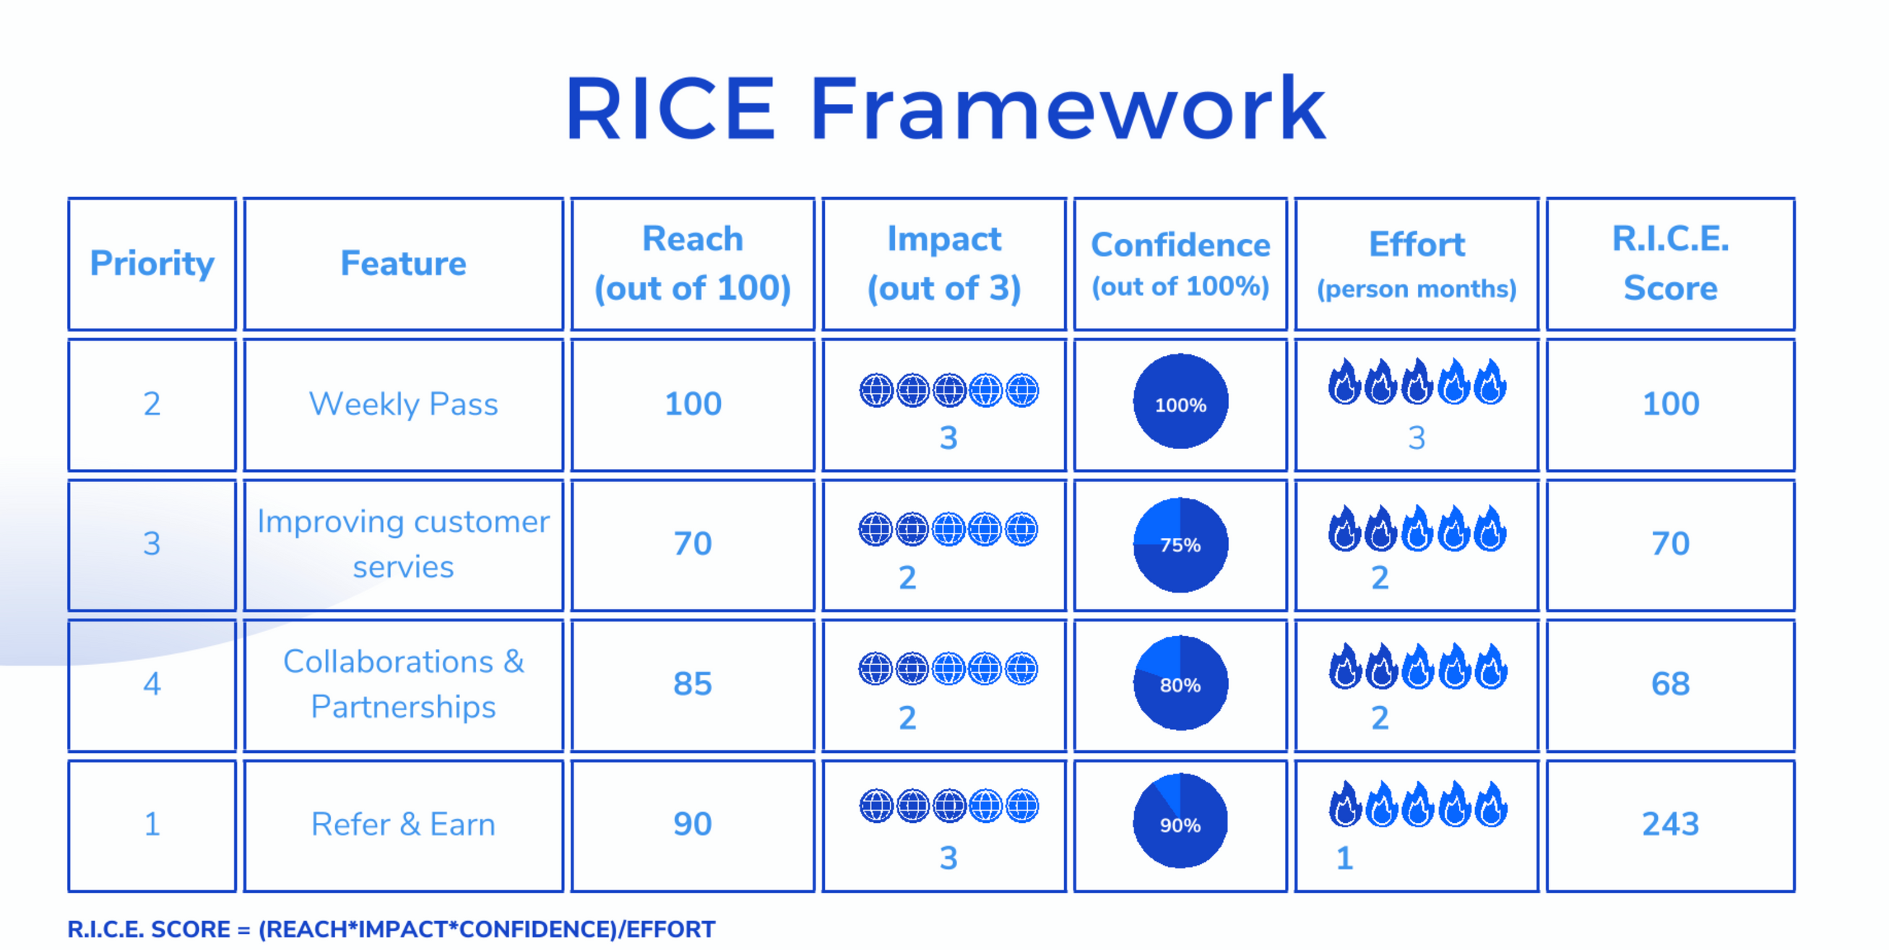

Slide 14
Measuring success
14
Identifying the Target Audience:
Conduct thorough research to understand user demographics, preferences, and behaviors. This ensures that services are tailored to meet the needs of specific customer segments effectively.
Product Positioning:
Clearly define and communicate the unique value proposition of BluSmart’s transportation services. Highlight distinguishing features, such as eco-friendly vehicles or luxury options, to stand out from competitors.
Marketing Strategy | Fiscal Year 2020
Pricing Strategy:
Develop a pricing model that strikes a balance between profitability and competitiveness. Factor in variables such as distance, time, demand, and market conditions. Utilize attractive promotions and incentives to encourage early adoption among users.
Feedback Collection and Iteration:
Regularly collect feedback from customers regarding their experiences with new features or services. Use this feedback to measure progress against key performance metrics and refine strategies for optimized outcomes.

